Slide 1
MINE RESCUE
AND
RECOVERY

Slide 2



Slide 3
MINE RESCUE
Deals with all measures and devices used for working in irrespirable and toxic atmospheres occurring in mines for
  firefighting and sealing off mine fires and
  conducting rescue and recovery operations speedily and safely.
Saving of lives of men overcome by toxic gases or O2-deficient atmospheres is the most important objective of mine rescue.

Slide 4
In the event of a fire or explosion in underground coal mines, the air is likely to be irrespirable because of toxic gases or the absence of O2.
Therefore, all underground coal miners are required to have access to emergency escape breathing apparatus.
In order to recover the mine after a fire or explosion, or to rescue trapped miners, mine rescue teams use long-duration, closed-circuit, self-contained breathing apparatus for respiratory protection.
These are commonly called rescue breathing apparatus (RBA).

Slide 5
Rescue equipment and their uses
Mine rescue apparatus, also called respirators or respiratory protective equipment primarily provides protection to human breathing system against poisonous and irrespirable gases.
It includes:
  Reviving apparatus
  Escape apparatus
  Self rescuers
  Gas masks and
  Self-contained breathing apparatus with compressed O₂ or liquid O₂.

Slide 6
Rescue apparatus are primarily used for
  respiratory protection of men employed in fighting mine fires and
  in rescue and recovery work after explosions.
Classification of rescue apparatus
Generally fall into the following three main classes:
a. Self-contained breathing apparatus (SCBA)
b. Filter apparatus or filter respirators
c. Fresh-air tube breathing apparatus or supplied air respirators.

Slide 7
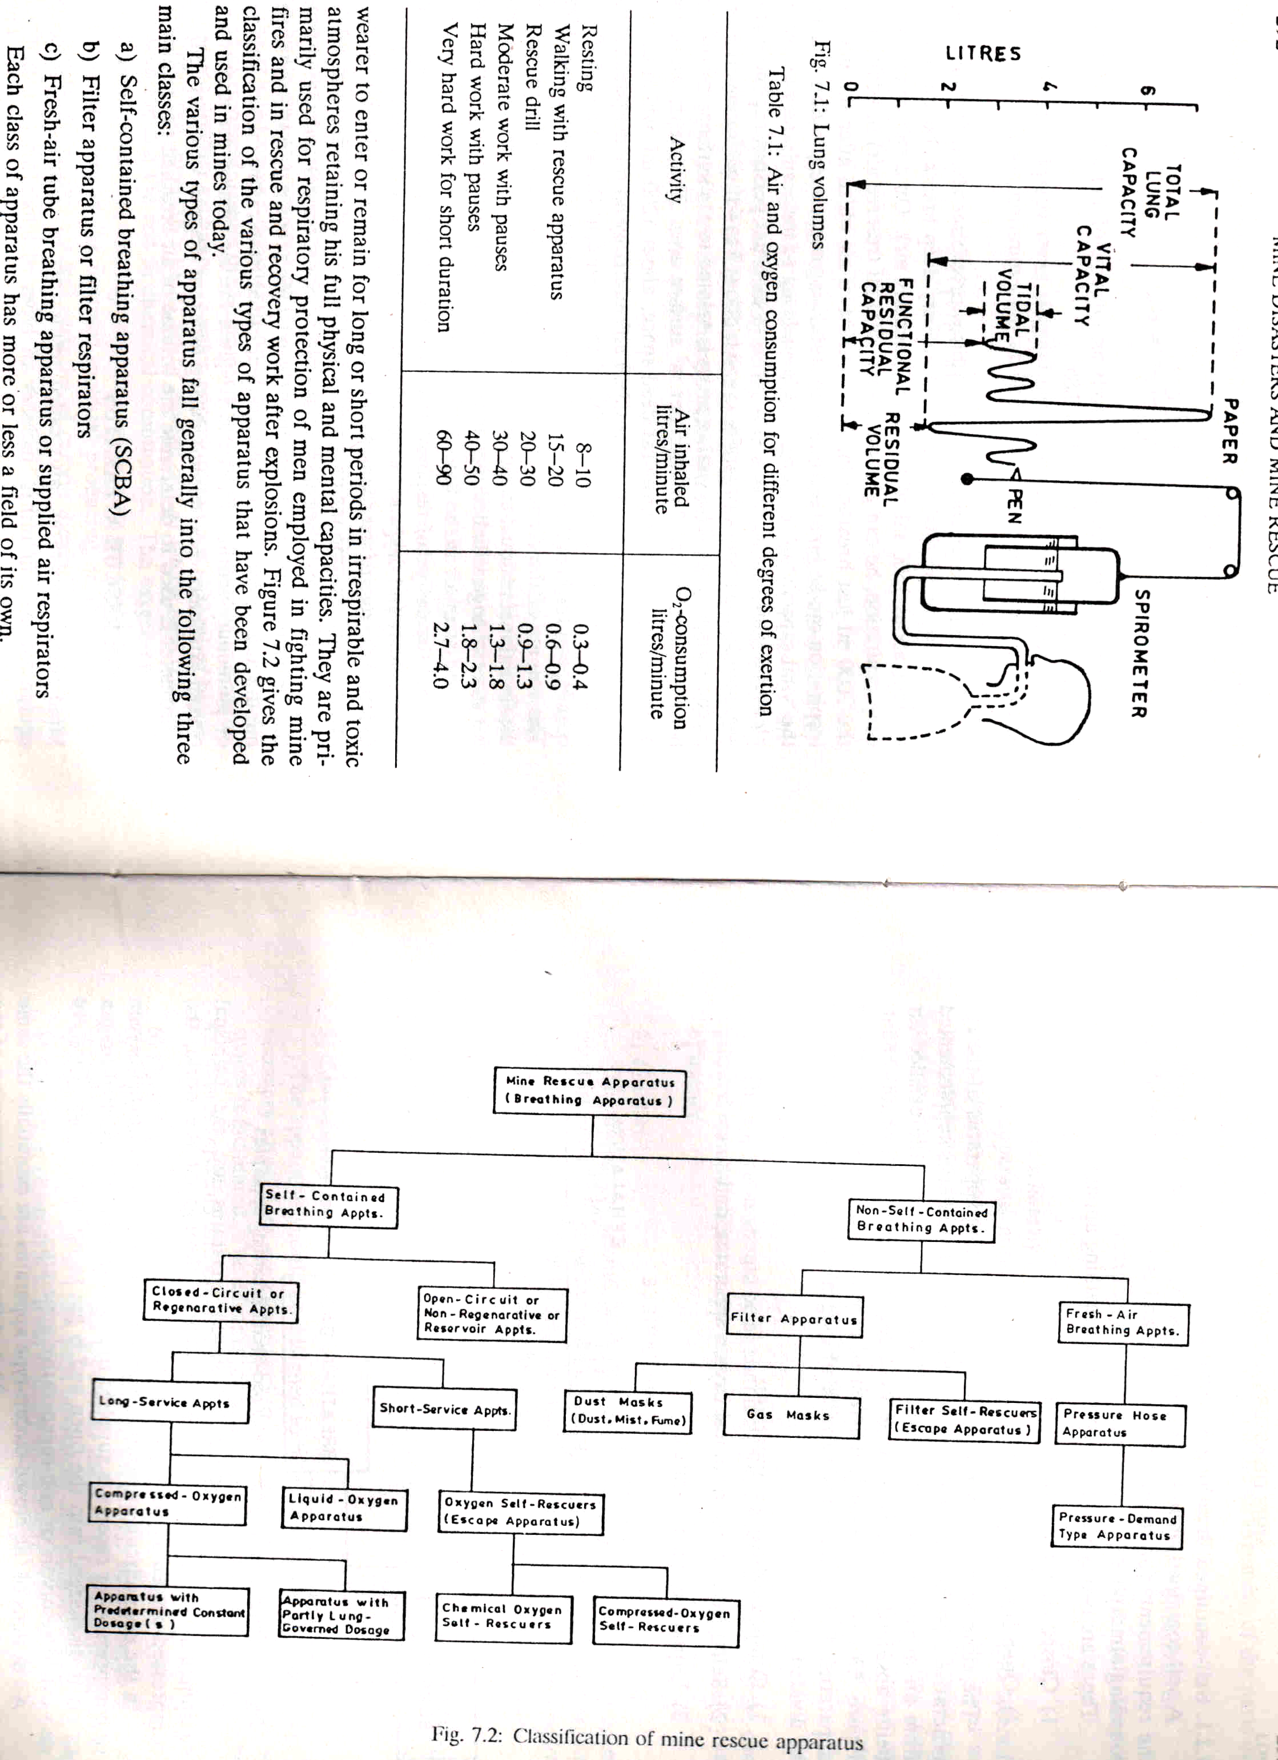

Slide 8
HUMAN RESPIRATORY SYSTEM
When a person inhales air or O2, it is drawn into the lungs down the trachea (windpipe) due to rhythmical respiratory movements of the chest.
The trachea divides into a no. of bronchial tubes which end in multitudes (altogether 6 millions) of minute air-sacs or alveoli which form the ultimate structure of the lungs.
The alveoli are lined with a thin membrane over which the circulating blood is spread in microscopic network of myriad capillaries which, if joined in one tube, would stretch over 3000 km and the red cells in them would have a surface for absorption of O2 of about 100 m2.
During the brief exposure in the alveoli, there is interchange of gases between the air and the blood and the red cells of the venous blood combine with a fraction of the inhaled O2 depending on the quantity and ability of the contained haemoglobin, while the blood parts with its CO2 and water vapour (respiratory exchange).
Under normal conditions, 100 ml of blood carry from the lungs 18.5 to 20 ml of O2 out of which only 0.36 ml is in solution and the rest in chemical combination.
The circulating blood requires a continuous intake of O2 and the lungs require an intermittent intake of O2 but in a regular way which is provided by human breathing.
If the supply of O2 to the blood stream or the lungs is stopped for a few seconds, it results in death.

Slide 9
Respiratory quotient
(or RQ or respiratory coefficient)
It is a unit less number used in calculations of basal metabolic rate (BMR) when estimated from CO2 production.
The CO2 given out is often less than
RQ is calculated from the ratio:
RQ = CO_{2 eliminated} / O_{2 consumed}
It depends on the type of diet taken. With normal diet, RQ = 0.85.

Slide 10
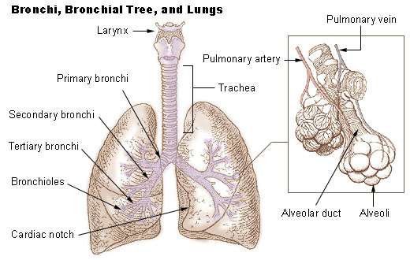

Slide 11
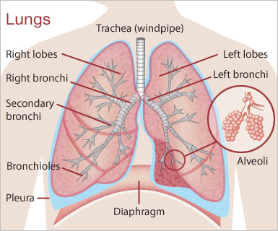

Slide 12
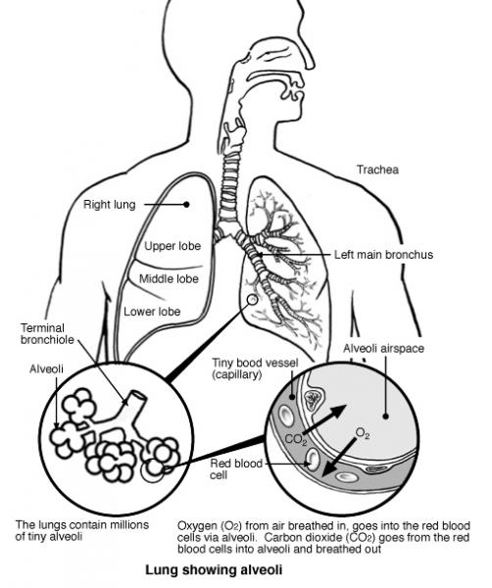

Slide 13
Vital capacity is the maximum amount of air a person can expel from the lungs after a maximum inspiration. It is equal to the inspiratory reserve volume plus the tidal volume plus the expiratory reserve volume.
A person's vital capacity can be measured by a spirometer which can be a wet or regularspirometer. In combination with other physiologicalmeasurements, the vital capacity can help make a diagnosis of underlying lung disease. The unit that is used to determine this vital capacity is millilitres (ml).
A normal adult has a vital capacity between 3 and 5 litres. After the age of 20 the vitalcapacity decreases approximatley 250 cc per ten years.

Slide 14
Fig. Lung volumes

Slide 16
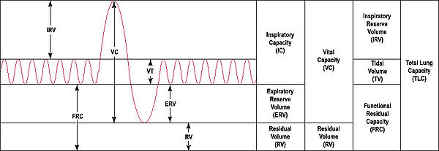
Output of a 'spirometer'

Slide 17
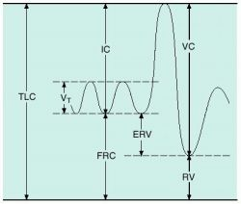
Subdivisions of total lung capacity: TLC, total lung capacity; VT, tidal volume; IC, inspiratory capacity; FRC, functional residual capacity; ERV,expiratory reserve volume; VC, vital capacity; RV,residual volume.

Slide 18
capacity /ca·pac·i·ty/ (kah-pas´ĭ-te) the power to hold, retain, or contain, or the ability to absorb; usually expressed numerically as the measure of such ability.forced vital capacity (FVC) vital capacity measured when the patient is exhaling with maximal speed and effort.
functional residual capacity the amount of air remaining at the end of normal quiet respiration.
heat capacity the amount of heat required to raise the temperature of a specific quantity of a substance by one degree Celsius. Symbol C.
inspiratory capacity the volume of gas that can be taken into the lungs in a full inhalation, starting from the resting inspiratory position; equal to the tidal volume plus the inspiratory reserve volume.
maximal breathing capacity maximum voluntary ventilation.
thermal capacity heat c.
total lung capacity the amount of gas contained in the lung at the end of a maximal inhalation.Subdivisions of total lung capacity: TLC, total lung capacity; VT, tidal volume; IC, inspiratory capacity; FRC, functional residual capacity; ERV,expiratory reserve volume; VC, vital capacity; RV,residual volume.
virus neutralizing capacity the ability of a serum to inhibit the infectivity of a virus.
vital capacity VC; the volume of gas that can be expelled from the lungs from a position of full inspiration, with no limit to duration of inspiration; equal to inspiratory capacity plus expiratory reserve volume.

Slide 19
GENERAL FEATURES OF THE APPARATUS
All of the apparatus are similar in their basic functions, which are to provide O2 to, and absorb CO2 produced by, the user.
The standard parts of the breathing apparatus coming into contact with the user's exhaled air are the face mask, breathing hoses, CO2-absorbent canister, and breathing bag.
O2 is stored in the apparatus as either a solid (potassium superoxide (KO2)), a liquid, or a gas.
The CO2 absorbents used were lithium hydroxide (LiOH), calcium hydroxide (CaOH), sodium hydroxide (NaOH), or a combination of these usually simply poured into a canister (packed-bed design).
In general, exhaled air is channeled through the exhalation breathing hose to the CO2-absorbent canister where the user's CO2 is absorbed, and then to the flexible breathing bag. It is stored there until it is drawn through the inhalation hose and into the user's lungs upon inhalation.
In most compressed-O2 apparatus, the O2 flows at a constant rate to the breathing bag and is supplemented at times of higher O2 consumption by a demand valve triggered by either low bag volume or a threshold inhalation pressure.
In contrast, when O2 consumption is lower than the constant flow, the breathing bag fills to capacity and begins venting to ambient through a relief valve triggered by either high bag volume or a threshold exhalation pressure.

Slide 20
Self-contained breathing apparatus (SCBA)
It is an apparatus that supplies all the requirements for respiration by itself and is independent of the surrounding atmosphere.
The O2 supplied to the wearer is not lost to the atmosphere during exhalation but is reused after the exhaled air is freed of CO2 by chemical absorbents.
It is worn by rescue workers, firefighters, and others to provide breathable air in an IDLH (Immediate Danger to Life and Health) Atmosphere.
Sometimes referred to as a Compressed Air Breathing Apparatus (CABA), air pack, or simply Breathing Apparatus (BA).
Types: Of two types
  Closed-circuit apparatus
  Open-circuit apparatus

Slide 21
Closed-circuit apparatus: it is regenerative type in which O2 used up by the wearer is supplemented from an O2 reserve.
The unwanted CO2 in exhaled air is absorbed at the same time by a regenerating chemical absorbent.
Depending on the source of O2 supply, it may be divided into:
  Compressed-oxygen apparatus: most commonly used by all mine rescue stations throughout the world
  Self-generating or chemical oxygen apparatus and
  Liquid-oxygen apparatus.
Open-circuit apparatus: Also called reservoir or non-regenerative apparatus.
O2 or compressed air reserve is supplied to the wearer and
the exhaled O2 or air is discharged into the open and is put to no further use.

Slide 22
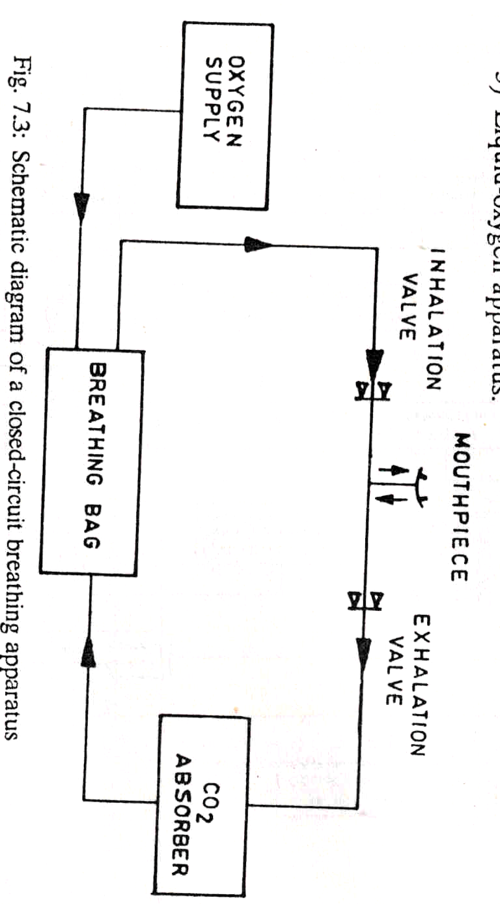
Fig. Schematic diagram of a closed-circuit breathing apparatus

Slide 23
General requirements of self-contained breathing apparatus
The apparatus are designed with the following objectives
Safety and reliability: apparatus must be designed on sound engineering and scientific principles so that it is safe and reliable when used under the most unfavorable and dangerous conditions encountered in mining.
Simplicity: should be as simple as possible in design
Comfort: it should give max possible comfort to the wearer under adverse operating conditions.
It should provide
  as cool an air as possible,
  maintain low levels of CO2 in the inspired air,
  offer low resistance to breathing, and
  have suitable head harness.

Slide 24
Weight: should be reasonably light when completely assembled and fully charged so that the wearer will be able to perform a larger amount of work.
Compactness: should be as compact as possible and unnecessary projections are eliminated so that work in intricate and confined spaces is facilitated.
Durability: should be robust in construction.
Before officially approved for use in mines, all individual parts of the apparatus must pass laboratory and practical approval tests.

Slide 25
The design and construction must:
Permit the apparatus to be worn without undue discomfort and in such a manner that it is practicable for the wearer to escape and not unduly impede the wearer when walking or in a crouching position, crawling or maneuvering in confined areas
Give trouble free operation over the range of -5°C to 60°C.
Prevent leakage from the circuit to atmosphere except through a relief valve or exhalation valve on compressed air apparatus.
Allow parts of the apparatus to be effectively sealed from atmospheric air during storage.
Be such that the use of aluminium is limited to those applications that may be justified on the grounds of safety and health.
Where change-over is required, be designed for easy removal when changing from one unit to another. For example, have neck straps with easy release clips.

Slide 26
General design requirements of closed-circuit modern self-contained compressed-O2 breathing apparatus
A steel cylinder: of 1 or 2 ltr capacity containing medical O2, under pressure not less than 120 bar (usually 135, 150, 200 or 300 bar) for supplying the wearer with O2.
The cylinder is fitted with a main valve which should be opened fully and locked in the open position when the apparatus is being worn.
A pressure reducing valve: to reduce the pressure of the O2 contained in the cylinder and
allow it to be supplied to the wearer at a fixed rate and at a pressure slightly higher than the atmosphere.

Slide 27
A regenerator purifying canister or purifier cartridge: to absorb the CO2 exhaled by the wearer.
It is a removable sheet metal container filled with a specially prepared chemical which will completely absorb CO2 over the prescribed wearing period.
As a regenerative chemical, alkali (anhydrous sodium hydroxide), lithium hydroxide, and soda-lime (a mixture of NaOH and CaOH) are used.
A breathing bag: to serve as an air reservoir from and into which the wearer breaths.
It also provides flexibility to the circulatory system.
It is made of high-grade rubber and of 4 to 6 ltr capacity.

Slide 28
A mouthpiece or facepiece assembly: to permit breathing entirely through the mouth or nose.
The all-vision or wide-vision facepiece covering the whole face permits breathing through the nose and also protects the eyes without use of goggles.
The mouthpiece assembly consists of
  A soft rubber mouthpiece shaped to fit smugly between the lips and teeth of the wearer
  A nose clip
  A T-shaped connecting piece
  Two inhalation and exhalation breathing tubes that connect the rest of the apparatus
  A head harness that holds the mouthpiece in place.
The headpiece assembly consists of
  A moulded rubber facepiece
  A connecting piece and
  Breathing tubes

Slide 29
The breathing tubes: of 25-mm dia strong highly flexible, deeply corrugated tubes of ageing resistance rubber with a fabric insert or neoprene.
Inhalation and exhalation valves: to compel circulatory air to travel in one direction.
Usually spring loaded mica-disc type or of neoprene rubber type and extremely sensitive.
A pressure gauge: to indicate the wearer the available supply and duration of O2 in the cylinder.
A bypass valve: to supply O2 direct to the wearer should the reducing or the lung-governed valve through any cause fail to act properly.
Usually designed as a self-closing push-button valve.

Slide 30
A lung-governed O2 admission valve or regulator: to supply the wearer with O2 in the exact quantity which his exertion may demand.
Warning signals or alarms: to give a clearly audible whistling or hooting sound in case
  the reducing valve fails to shut off at the proper pressure or
  the cylinder is approaching exhaustion.
A relief or excess pressure valve: to release any excess pressure and to avoid accumulation of N2 in the respiratory system.
May be located on the face piece or on the breathing bag and operated manually or automatically by the breathing bag itself when it expands.
A pre-flushing device: to automatically flush out the apparatus with 7-8 ltrs of O2 when the cylinder valve is opened to purge the N2-rich ambient air initially found in the breathing circuit.

Slide 31
A saliva trap: to accumulate saliva of the wearer.
May be provided with a release valve to permit discharge of saliva accumulation.
Located either in the inhalation tube or at the base of the mouthpiece or face piece.
A casing: to protect the breathing bag, regenerator, reducing valves and other vital parts against direct blows and falling material.
Made of light metal of great strength, tough moulded fibreglass, or stainless steel
So designed to permit ease passage through narrow mine workings.

Slide 32
Draeger BG-174
It is a compressed O2 type closed-circuit apparatus with a constant and lung-governed dosage of O2.
Manufactured by Draeger AG Co., Lubeck, Germany
Main specifications:
Safe working period : 4 hrs hard work
Cylinder capacity (empty) : 2 ltrs
Cylinder capacity with O2 at 200 kg/cm2 : 400 ltrs
Breathing bag capacity : 6 ltrs (approx.)
Wt. of the apparatus (fully charged) : 12.8 kg
O2 flow rate : 1.5 ltr/min
O2 feed by lung governed valve : as required by wearer

Slide 33
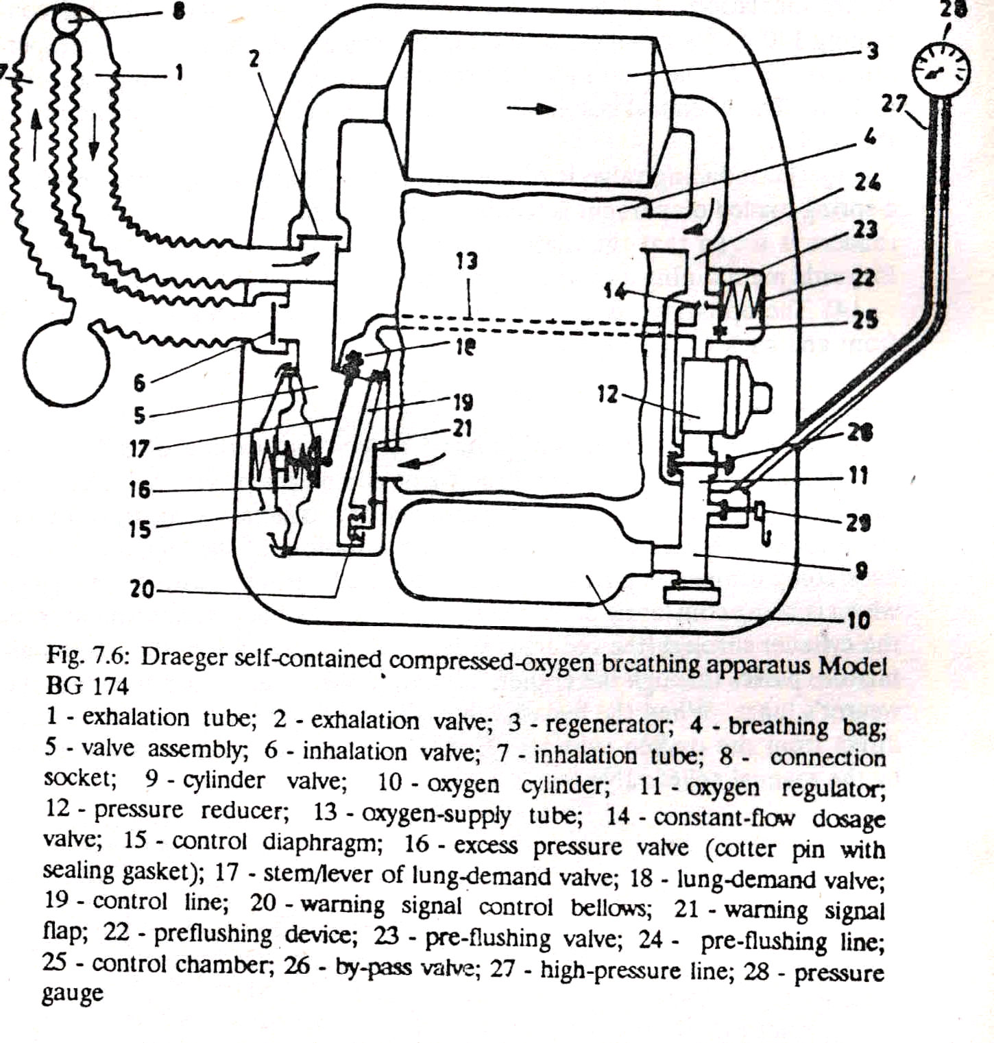

Slide 34
Special features of the apparatus BG-174
The O2 regulator comprises a pressure reducer, an automatic preflushing device, a bypass valve, and a pressure gauge shut-off valve.
The lung-demand valve is a diaphragm-operated stem valve in a valve box or housing and operated by the diaphragm responding to small –ve pressures resulting from inhalation.
A pre-flushing device fitted to automatically purge the breathing circuit of N2 with a burst of about 7 litres of O2 when cylinder valve is opened.
Apparatus is mounted on the back of the wearer.
A dry ice cooler may be substituted for the saliva trap in the inhalation tube to cool the inhaled air temp. to 15ºC.
Anhydrous NaOH (1.5 kg) is used as CO2 absorbent.

Slide 35
Air circulatory system
Exhaled air containing CO2 and excess O2 flows through the exhalation tube, exhalation valve into CO2 absorption canister where it is freed from CO2.
The purified air flows into the breathing bag.
On inhalation, it is drawn from breathing bag into long-demand valve housing where it gets enriched with O2 and then flows through the inhalation tube into the wearer’s lungs.
Excess pressure build up is prevented by the automatic relief valve.
Additional O2, if needed, is provided by the lung-demand valve.

Slide 36
Draeger BG-174A
It is a compressed-O2, closed-circuit apparatus with a disposable CO2-absorbent canister.
It is the most widely used long-duration closed-circuit breathing apparatus in the world.
Originally certified in 1966 by the former U.S. Bureau of Mines (USBM) as a 2-hr apparatus, it was NIOSH-certified in 1975 as a 4-hr apparatus.
The O2 cylinder contains approximately 395 L of O2 at the recommended fill pressure of 200 bar at room temperature.
It has a constant flow of O2 of 1.5 L/min plus a pressure-activated demand valve.
The relief valve is also pressure-activated.

Slide 37
The CO2 absorbent is NaOH suspended in a crisscross, corrugated-screen bed (figure) designed to prevent the NaOH from melting into a solid mass during use.
The user exhales into the face mask, through the exhalation hose, past the exhalation check valve, through the CO2-absorbent canister, and into the breathing bag.
Upon inhalation, the user draws air from the breathing bag, through the valve box and inhalation check valve, through the inhalation hose, and back to the face mask.
The face mask includes a wiper that removes condensation from the inside of the lens.
A preflushing device operates when the O2 cylinder is opened and fills the breathing bag with approximately 6 L ATPD of O2, purging the circuit of a large quantity of N2.
If the user's O2 consumption rate is higher than the O2 constant flow rate and the circuit contains a large quantity of N2, the O2 concentration in compressed-O2 apparatus can fall to subambient levels before the demand valve is activated.

Slide 38
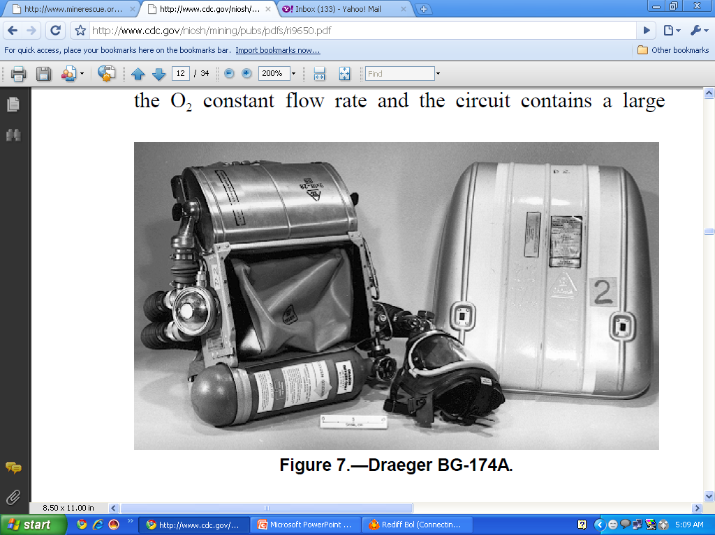

Slide 39
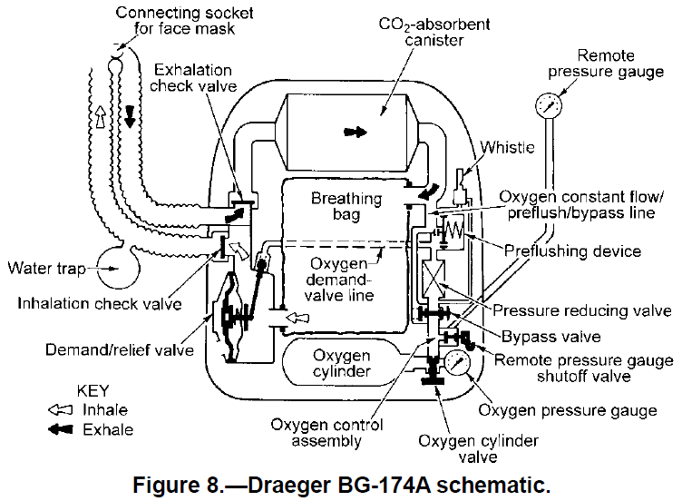

Slide 40
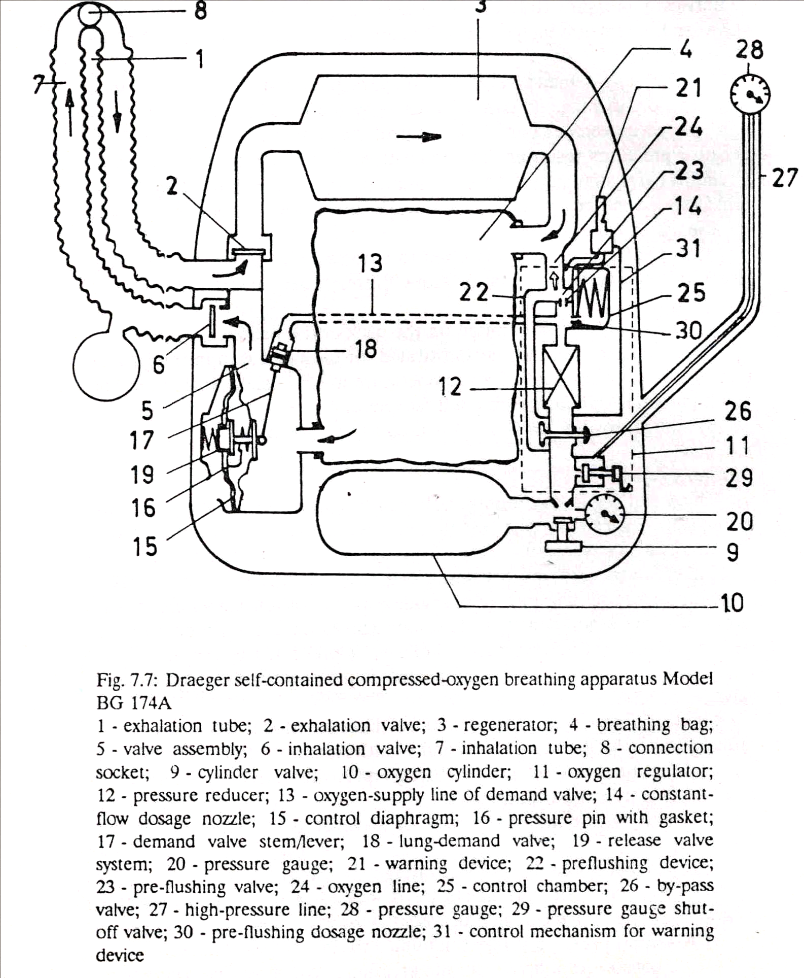
3

Slide 41
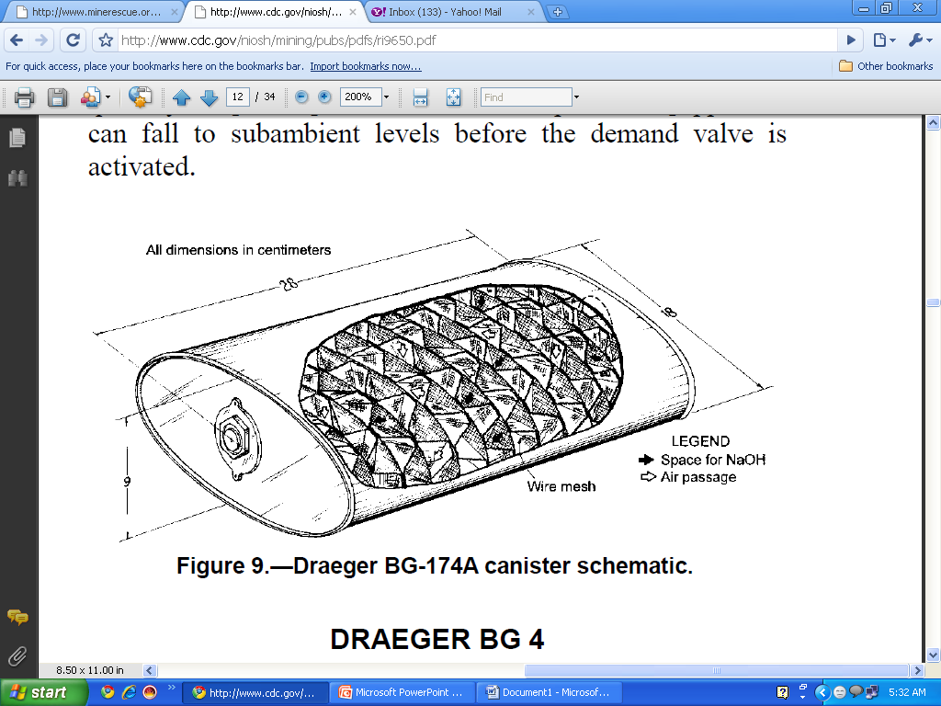

Slide 42
Additional features in Draeger BG-174A
BG-174A is essentially same as Draeger BG-174 except for the following:
It has 3- and 4-hour approval ratings.
The low-O2 warning device is located in the O2 regulator instead of in the demand regulator assembly or valve box.
A second pressure gauge is mounted on the O2 cylinder.
It incorporates a divider in the breathing hose facepiece connector.
The O2 metering nozzle is located on the O2 regulator.
The cylinder valve is of ‘step clutch’ design.

Slide 43
Draeger BG 4
It is a compressed-O2, closed-circuit apparatus with a disposable soda lime CO2-absorbent canister
It has been NIOSH-certified four times (1995) as both a 3- and 4-hr apparatus and a standard- and positive-pressure apparatus.
The 4-hr, positive-pressure version of the BG 4 was tested using the same O2 cylinder as that used for the BG-174A, which has the same recommended fill pressure of 3,135 psi at room temperature.
The 3-hr version comes with a fiberglass-wrapped cylinder. The BG 4 has a constant flow of O2 of at least 1.5 L/min ATPD plus a volume-activated demand valve.
The relief valve is also volume-activated and purges exhaled air before it enters the CO2-absorbent canister.

Slide 44
The face mask is the same as that used with the BG-174A.
The user exhales into the face mask, through the exhalation check valve and breathing hose, through the CO2-absorbent canister, and into the spring-loaded breathing bag.
Upon inhalation, the user draws air from the breathing bag, through the heat-absorbent canister, the inhalation hose and check valve, and back to the face mask.
The heat-absorbent canister works by routing inhalation air around a chamber containing a large cylinder of ice inserted just before use, formed in a separate ice mold.

Slide 45
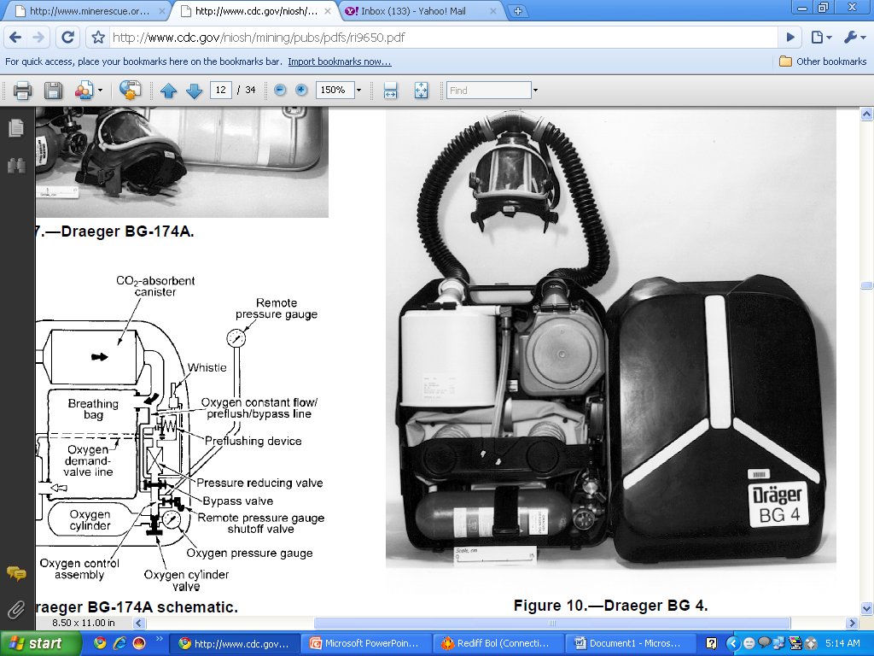

Slide 46
